Slide 1
Website for blood DONors details
.

Slide 2
SYNONPSIS
MODULES:
HOME
FACTS
BLOOD DONOR LISTS
LOGIN
FEEDBACK
CERTIFICATE
IMAGES
XAMPP SERVER
DATABASE

Slide 3

home page:

Slide 4
Module home page
In home of the website is defines an history of blood donation in which one is started and what year started define an what procedure are use in blood donation.
The home module that is starting of the website in default one of website in module. Next History of blood Donor list page.

Slide 5


Slide 6
module facts
In module of facts is include an what are facts of blood donation ,procedure of blood donation , benefits of blood donation ,advantages and disadvantages of blood donation.
The facts of donation in what age will be limitation of blood donation. what will do before and after process of blood donation.

Slide 7
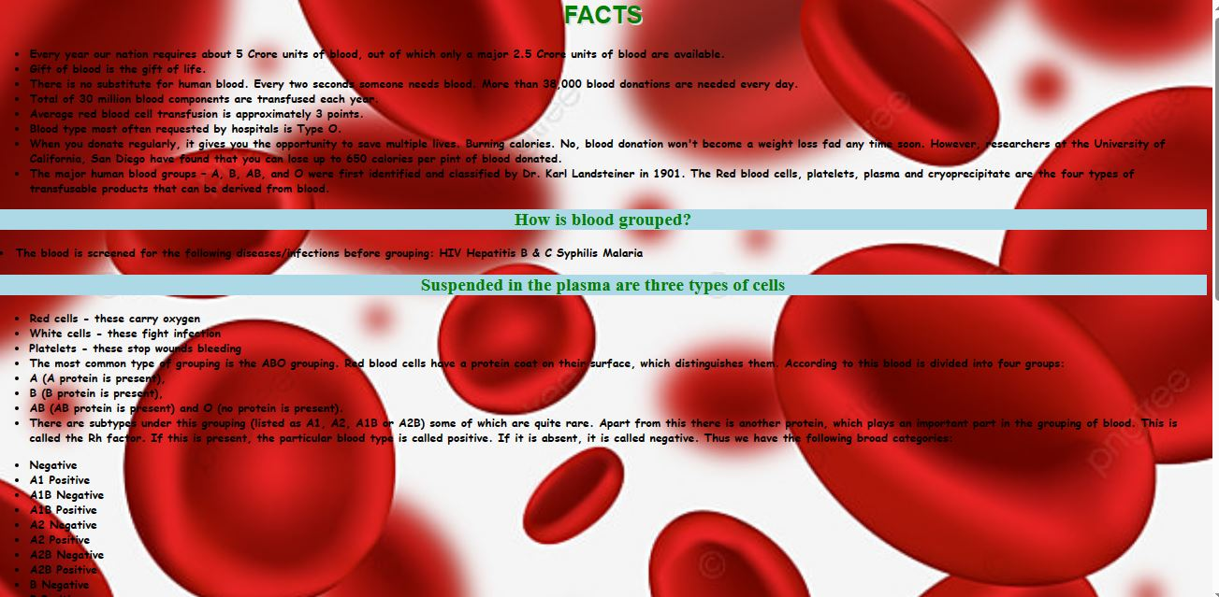
Screenshots of facts

Slide 8
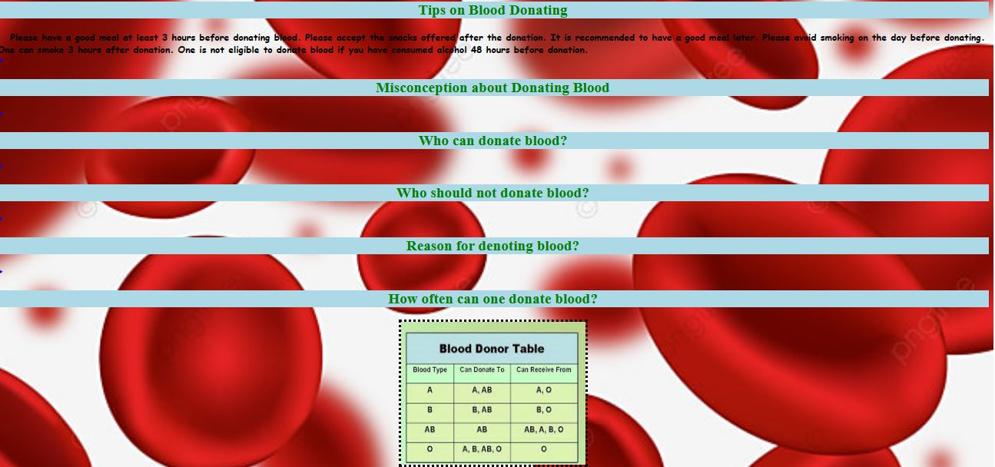

Slide 9
module blood donors list
In that module includes blood donors data has view in click blood donors to open a list box viewed an blood groups that will click to open an suitable blood group donors details has viewed.
In that list will click redirect to an database page to viewed an details of the donors .

Slide 10

Screenshot for blood donors list

Slide 11
LOGIN
Login form , utilizes the credentials of a user ,in order to authenticate their access.
Username is (donor name) , password is (donor date of birth). If you click Login button , its display the donors details. It’s updates the user details in form.
User can login in a form same person can modifying the update.
If we have update the user details ,data has store in database. User can view the database in our details.

Slide 12
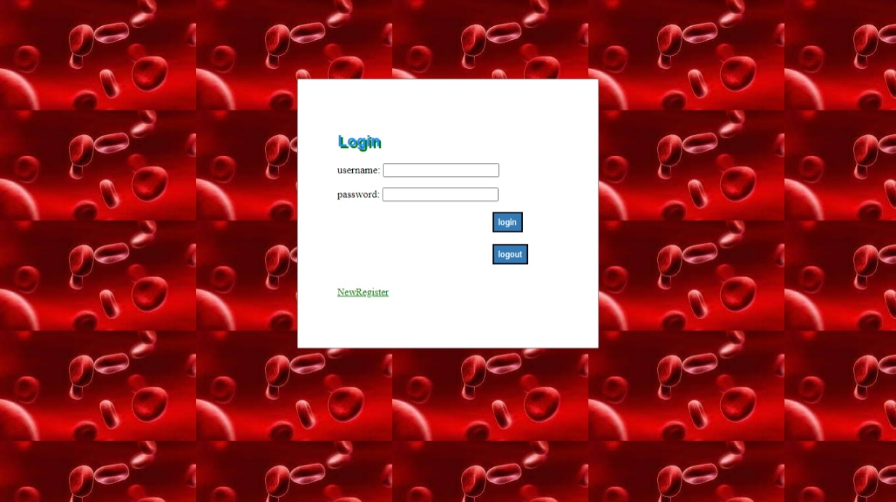

Slide 13
Module invite
In a invite module has an registration for newly register their details in our database and it will automatically add into the donor list details.
The invite form has that an name ,dob , Age, Gender, Address, Phone no , weight , blood group , Aadhaar no
place.
It especially after enter the date of birth, the age will automatically generated.

Slide 14
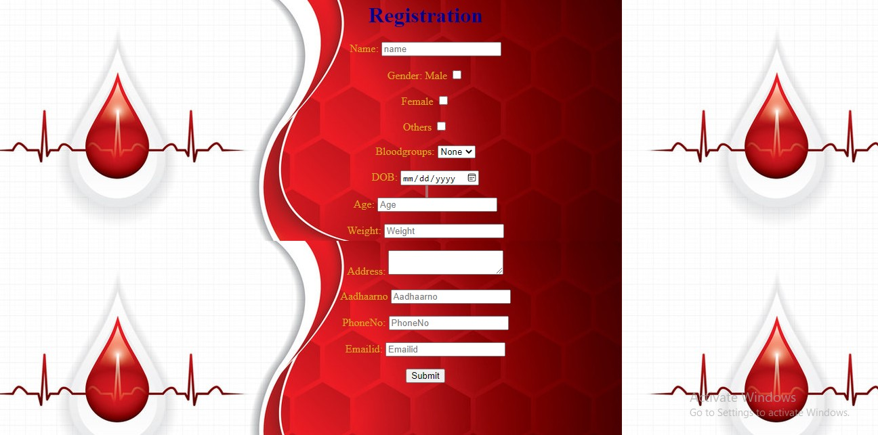
Screenshot of model Invite

Slide 15
DONARS FEEDBACK
“Give Blood Regularly , three to four times a year”.
Your Feedback is important to us , because a cooperative effort is the only way to achieve the best results.
The feedback is the final step of the process that ensures
that the donor or receiver has received or not.
So we added feedback page , it helps to improve or update the website. All Candidates can view the feedback page.
You need Any suggestions, for fill with the feedback page.

Slide 16
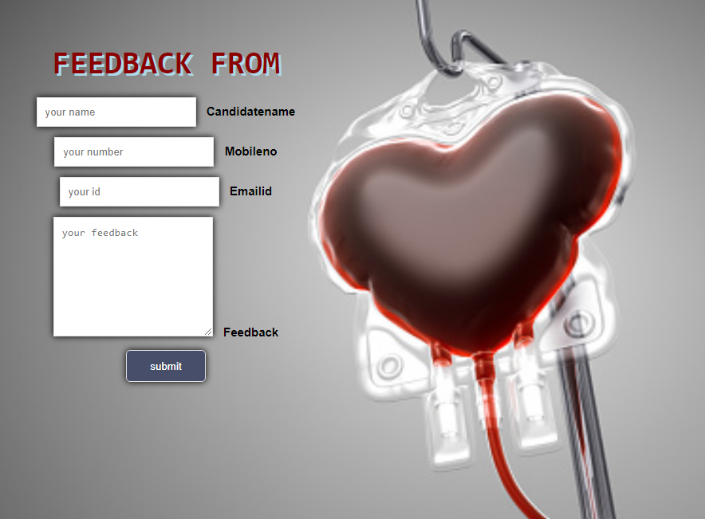
Screenshot of FEEDBACK

Slide 17
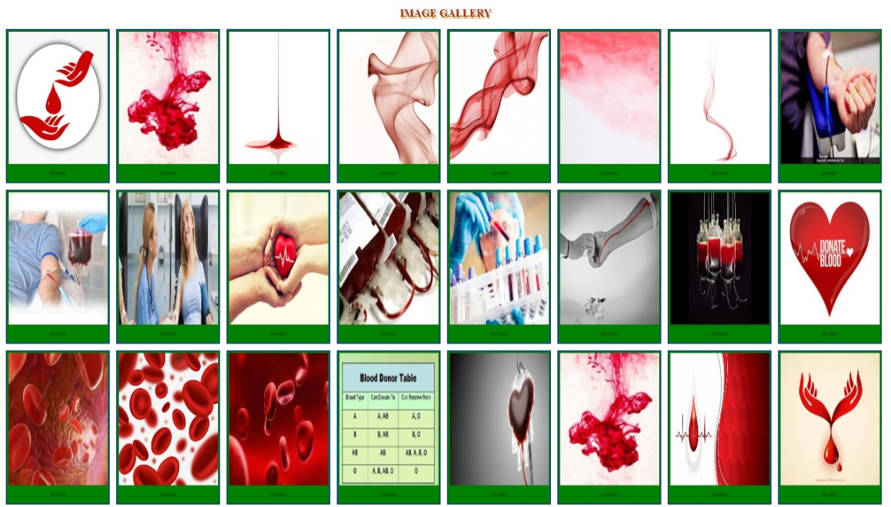
SCREENSHOT OF IMAGES PAGE

Slide 18

CERTIFICATE FOR DONORS

Slide 19
XAMPP Server
REQUIRMENTS:
XAMPP server procedure:
Start XAMPP server by Starting Apache and MySQL.
Write PHP script for connecting to XAMPP
Run it in the local browser
Database is successfully created which is based
On the PHP code.
path: http://localhost/phpmyadmin

Slide 20
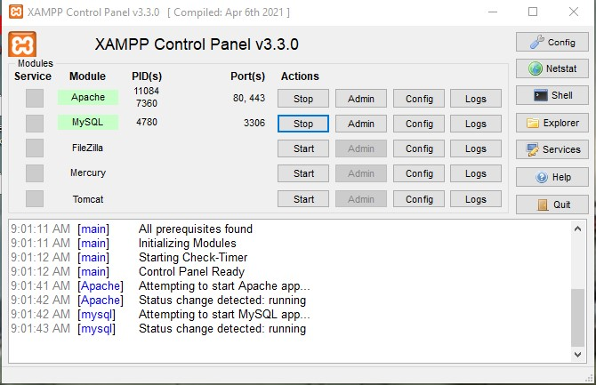
Screenshot of XAMPP

Slide 21
DATABASE
The collection of related data is called database. Data can view on database.
XAMPP stands for cross-platform MySQL, PHP.
It among the simple light –weight local servers
For website development.
steps:
open XAMPP and starting & running Apache , MYSQL.
Now open your PHP file & write your PHP code to create database & a table in your database.
save the file in “ list.php ” in folder the open our web browser and type http://localhost/phpmyadmin.
Finally the database is created and connected to PHP.
If you want to see your database just type http://localhost/phpmyadmin in web browser and the database can be found

Slide 22
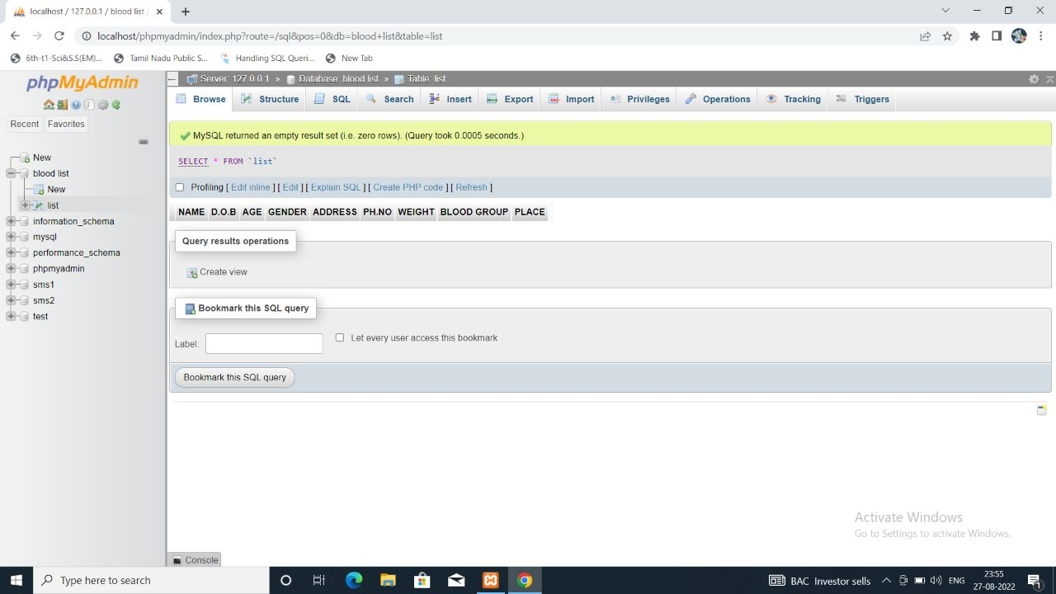
Screenshot of Database

Slide 23


